Slide 1
PASSWORD STRENGTH CHECKER

Slide 2
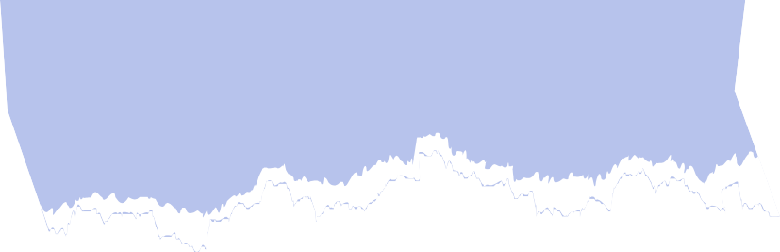

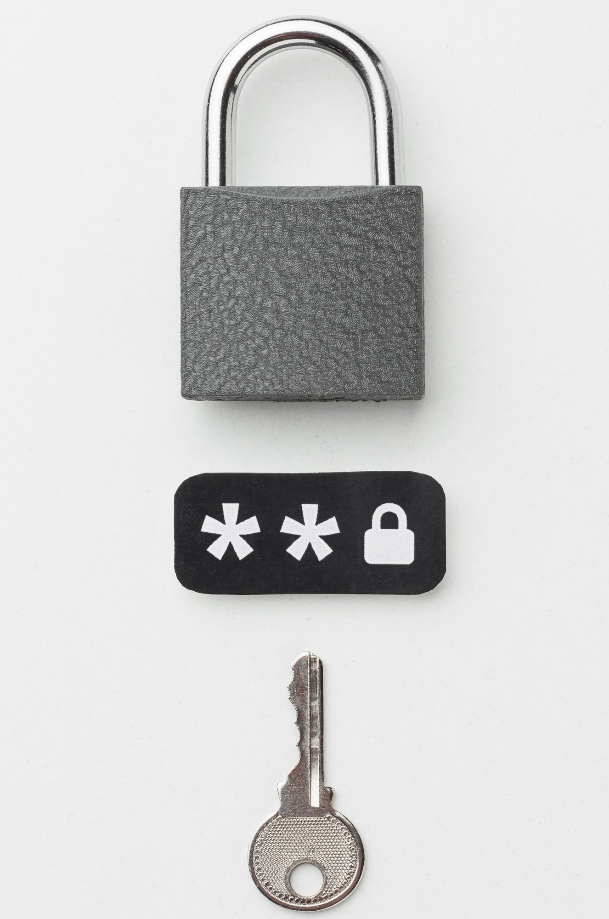
WHY IS PASSWORD SECURITY IMPORTANT ?
A password strength checker is essential for ensuring that users create strong passwords that are less likely to be cracked by attackers. Passwords are the primary security mechanism for user accounts, and weak passwords can leave users vulnerable to various attacks, such as brute-force attacks, dictionary attacks, and social engineering.

Slide 3


Where Password Strength Checkers are Used
Web Applications: Most websites and online platforms use password strength checkers to ensure users set secure passwords when creating accounts or changing passwords.
Mobile Applications: Mobile apps often incorporate password strength checkers to guide users in choosing strong, secure passwords.
Online Banking and E-commerce Sites: Websites that handle sensitive financial information, such as banking and e-commerce platforms, require strong passwords to prevent unauthorized access.
Password Managers: Password manager tools help users generate strong passwords by using strength checkers, ensuring that passwords are complex and hard to guess.

Slide 4

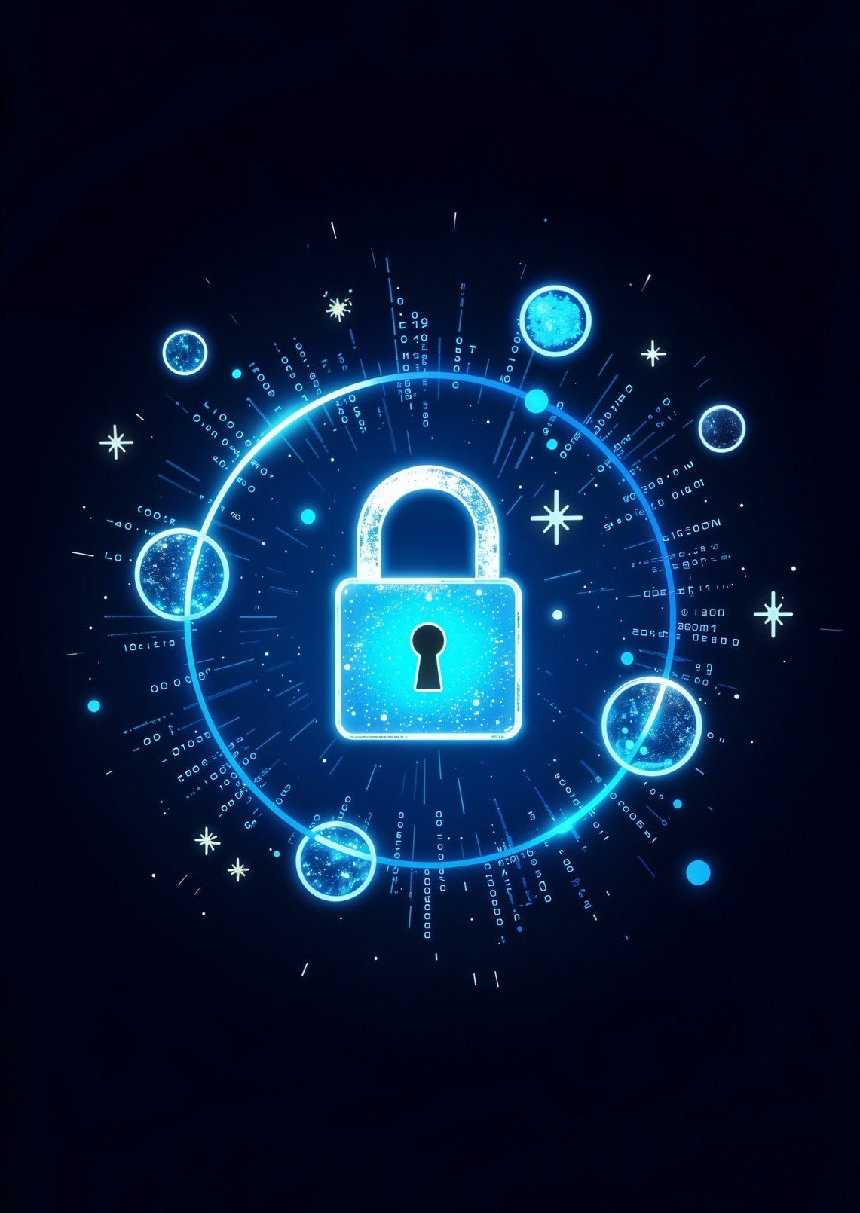

Characteristics of Strong Passwords
A strong password should be at least 8 characters long, include a mix of UpperCase and LowerCase letters, numbers, and special characters. Avoid using easily guessable information such as birthdays or common words. The more complex the password, the harder it is to crack.

Slide 5
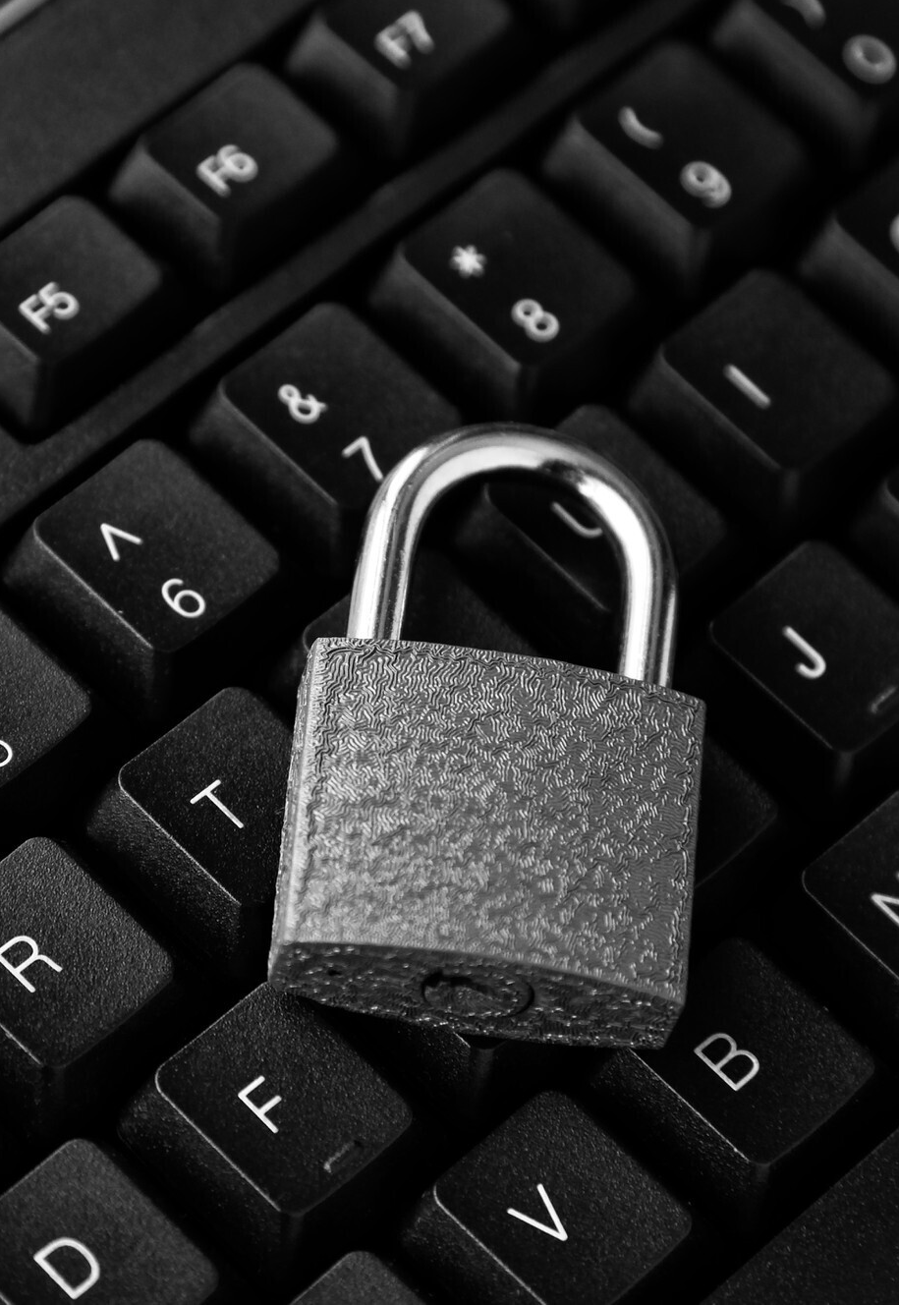
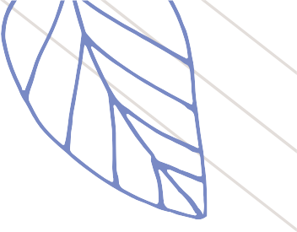
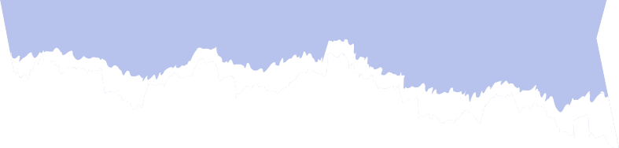


Technologies we used
HTML: Structures webpage content (headings, paragraphs, links, images, etc.).
CSS: Styles and visually formats the webpage (colors, fonts, layout, responsive design).
JavaScript: Adds interactivity and dynamic behavior (form validation, animations, content updates).

Slide 6
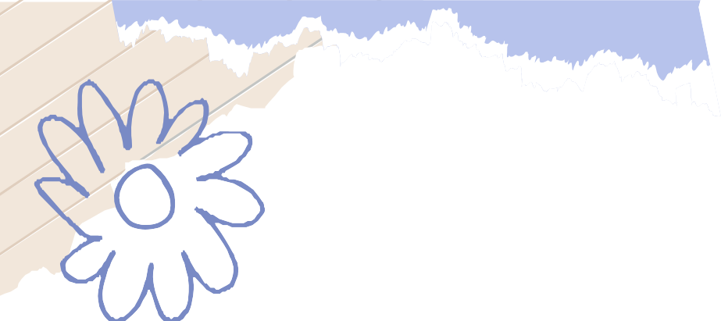
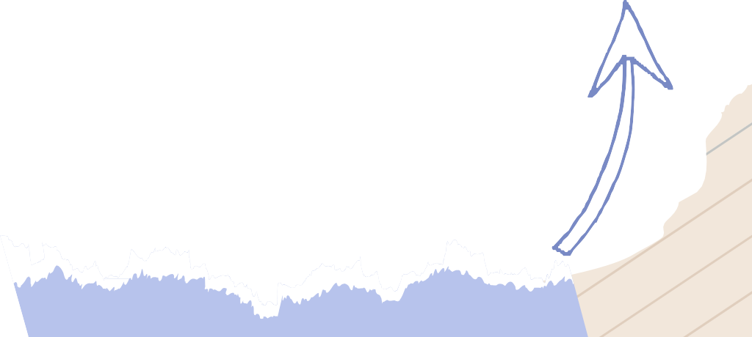
RELATION WITH DISCRETE STRUCTURES
1. Logic and Boolean Algebra
Use: The password strength evaluation is heavily dependent on logical conditions (if statements).
2. Sets and Membership
Use: Character classes (e.g., uppercase letters, lowercase letters, numbers, special characters) can be thought of as sets. The password is evaluated to determine if its characters belong to these sets.
3. Functions
Use: The project uses functions to encapsulate the logic for checking password strength. Functions are fundamental discrete structures for mapping input to output.
4. Counting and Probability (Optional Extensions)
Use: If expanded, this project could use counting principles to determine the number of possible strong passwords or evaluate password entropy for security.

Slide 7
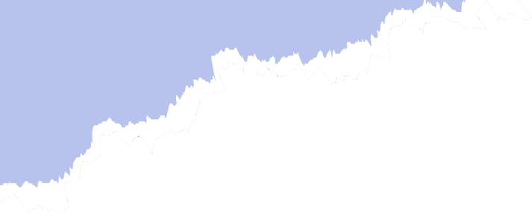
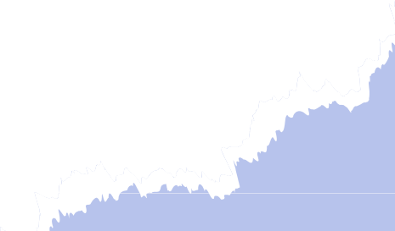
Conclusion: Strengthening Security
The Password Strength Checker project demonstrates how essential it is to ensure password security through clear guidelines and real-time feedback. By using a simple web-based tool, users can easily evaluate and strengthen their passwords to protect their online accounts and personal data. By incorporating password strength evaluation, this tool offers an easy and effective way for users to ensure that their passwords meet security standards.
This project also illustrates the importance of clear UI/UX design to provide immediate, actionable feedback to users, encouraging them to create stronger passwords and reducing security risks in the digital world.

Slide 8


Thanks!
Do you have any questions?
Abdul Moeez
Hashim Sultan
Abu Bakr Zahir
Abdul Ahad
Ali maan

